Slide 1


Nusrat Asrafi
24 October,2022

Slide 2

Outline
Executive Summary
Introduction
Methodology
Results
Conclusion
Appendix

Slide 3
Executive Summary
Summary of methodologies
Data Collection (API and Web scraping)
EDA (data visualization and SQL)
Map with Folium
Interactive Dash Board with plotly Dash
Predictive analysis
Summary of all results
EDA results from all sources
Interactive map and dashboard result
Prediction results from Models

Slide 4
Introduction
Project background and context
The cost effective space travel company is SpaceX. The company make spaceship in two stages. In the first stage the spaceship is made and the payload of the spaceship enclosed with the fairings. In the second stage The payload apart from the space station and moves into the orbits. The first stage is very long and expensive. The company reduces the cost of spaceship less than twice from ordinary spaceship by reusing first stage of spaceship launch.
Problems you want to find answers
If we can find out whether first stage of spaceship is successfully landed or not, we can make the price estimation of most cost effective spaceship.

Slide 5

Section 1

Slide 6
Methodology
Executive Summary
Data collection methodology:
Data Collected from SpaceX REST API and
Obtaining Falcon 9 Launch Data from Wiki Page by web scraping
Perform data wrangling
Find the patterns of data and determined the training levels
Perform exploratory data analysis (EDA) using visualization and SQL
Perform interactive visual analytics using Folium and Plotly Dash
Perform predictive analysis using classification models
Building machine learning pipeline with Logistic regression, SVM, Decision tree and KNN algorithms with Grid Search hyperparameter tuning and evaluated the process with confusion matrix to predict whether the first stage of Falcon 9 Launch will land or not.

Slide 7
Data Collection
Describe how data sets were collected.
Data Collected from SpaceX REST API and
Start to work on the RESTAPI endpoint api.spacexdata.com/v4/launches/past.
Perform a get request using the requests library to obtain the launch data in json format.
To convert launch data to pandas dataframe we use json_normalize() function
Obtaining Falcon 9 Launch Data from Wiki Page by web scraping
You need to present your data collection process use key phrases and flowcharts

Slide 8
Obtaining Falcon 9 Launch Data from Wiki Page by web scraping
Web scraping HTML Tables using the Python Beautiful Soup package
Parse the data from HTML tables and convert them into Pandas Data frame

Slide 9
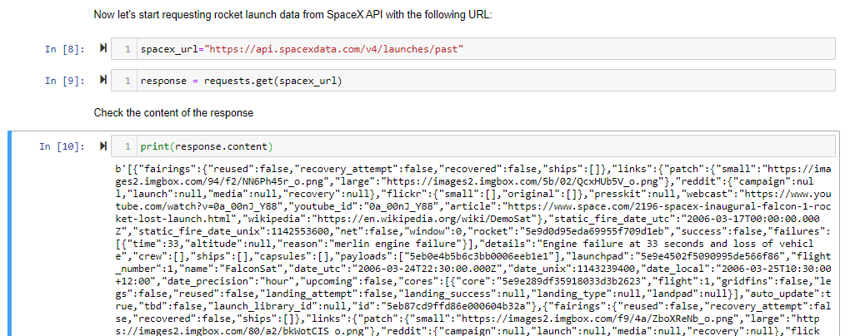
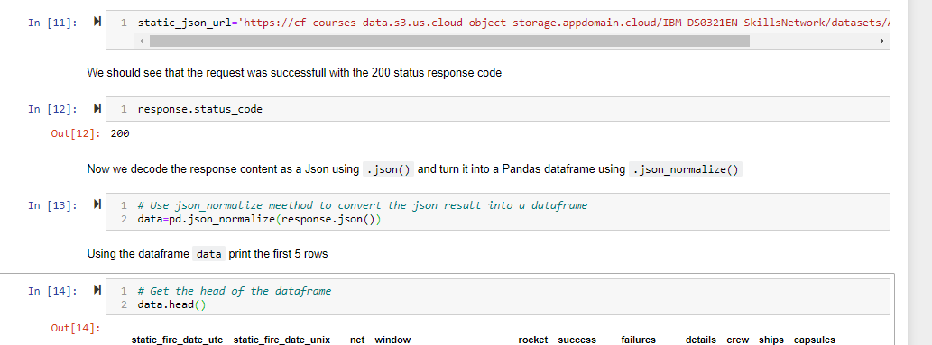
Data Collection – SpaceX API
Make a get request to the SpaceX API and clean the requested data and also do some basic data wrangling and formatting.
The link of my data collection API assignment is: https://github.com/NusratAsrafi/Caption-project-data-science/blob/main/jupyter-labs-spacex-data-collection-api%20(1)%20(1).ipynb
Place your flowchart of SpaceX API calls here

Slide 10
Data Collection - Scraping
First we request falcon 9 launch wiki page from its url,then extract all the column/variable name from html table with beautifulsoup object and then parse the table and convert it into pandas dataframe.
The Github link is:webscraping_of_falcon9_launch_data_from_wikipage
Place your flowchart of web scraping here

Slide 11
Data Wrangling
Perform data analysis by checking missing values and identify variable types for each variable
Finding the relationship between the number of incident and launch site, orbit type and mission outcome per orbit type individually
Determine training level by creating landing outcome label from Outcome column and create a new dataset with 'CLass' columns
The github link of data wrangling:data_wrangling_falcon9_launch_data

Slide 12
EDA with Data Visualization
We need to find which variable effects the successful launch landing
For this purpose we find out the relationship between flight number, payload and launch site. We plot scatter plot between flight number and payload, flight number and launch site, payload and launch site.
Each Launch site depends on specific orbit type so we find the relationship of orbit type with flight number and payload mass by plotting scatter plot individually
For successful launch landing we find the relationship between success rate and orbit type by bar chart
And finally to predict the successful landing we find out the success rate of launch landing per year.

Slide 13
EDA with data visualization
After selecting the related feature for successful prediction of launch site landing we will create a new dataset with the new feature and do some feature engineering.
In the new dataset ,the 'Orbit', 'LaunchSite','LandingPad','Serial' columns have categorical value. We convert those columns in numeric columns through one hot encoder and ready for ML algorithms
The GitHub URL of Data visualization with EDA: EDA_data_visalization

Slide 14
EDA with SQL
The main idea of the data analysis is to find out which attributes of the dataset ensure the safe landing of spaceship. By SQL queries we find out what types of launch site are available in the dataset, what are their payloads mass in terms of booster version, customers, the total number of successful and failure landing, when the successful landing happens in ground pad, the booster name which successfully landed in drone ship with payload mass in between 4000 and 6000, which launch site and booster version are failed in landing in drone ship in 2015 and count the landing outcome and rank it in desending order.
The GitHub URL of your completed EDA with SQL notebook : https://github.com/NusratAsrafi/Caption-project-data-science/blob/main/jupyter-labs-eda-sql-coursera%20(3)%20(1).ipynb

Slide 15
Build an Interactive Map with Folium
First we create map object .In this assignment we take NASA Johnson Space Center at Houston, Texas as an initial center location. We add circle and marker on the location.
Then from SpaceX dataset we add all the locations of launch site and add marker and circle on it .Then mark the success/failure launches for each site on map
Calculate the distance between a launch site and to its proximities.
The success rate of launch depends on the location and proximities of the launch site. By analyzing the initial position of rocket trajectories we could discover the factors depends on finding optimal location for building a launch site.
The GitHub URL of your completed interactive map with Folium map:https://github.com/NusratAsrafi/Caption-project-data-science/blob/main/lab_jupyter_launch_site_location_111%20(1).ipynb

Slide 16
Build a Dashboard with Plotly Dash
Explain why you added those plots and interactions
The GitHub URL of completed Plotly Dash lab: https://github.com/NusratAsrafi/Caption-project-data-science/blob/main/final_data_science_dash_application_project.ipynb

Slide 17
Predictive Analysis (Classification)
Create a machine learning pipeline to predict if the first stage will land given the dataset.
Perform exploratory data analysis and determine Training labels by creating a column for the class( target Y)
Standardize all the attribute of data
Split the data with train and test with parameter test_size to 0.2 and random_state to 2
he training data is divided into validation data, a second set used for training data; then the models are trained and hyperparameters are selected using the function GridSearchCV.
Four Machine learning mode i.e logistic Regression , SVM, Decision Tree, KNN are used to train and test data
For evaluation we used confusion matrix with cross validation 10
The GitHub URL of your completed predictive analysis lab https://github.com/NusratAsrafi/Caption-project-data-science/blob/main/SpaceX_Machine%20Learning%20Prediction_Part_5%20.ipynb

Slide 18
Results
Exploratory data analysis results
Interactive analytics demo in screenshots
Predictive analysis results

Slide 19

Section 2

Slide 20
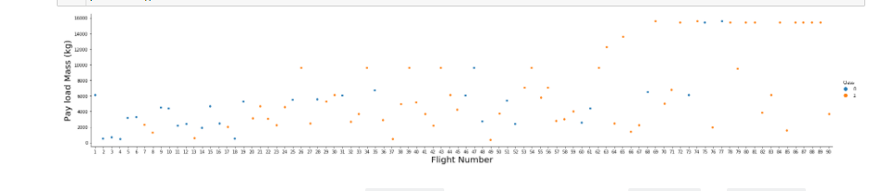
Flight Number vs. Launch Site
As the flight number increases the first stage is more likely to land successfully.
Different launch sites have different success rates. CCAFS LC-40, has a success rate of 60 %, while KSC LC-39A and VAFB SLC 4E has a success rate of 77%.

Slide 21
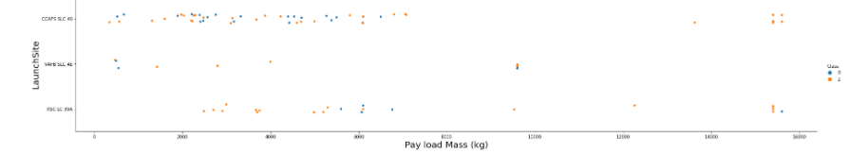
Payload vs. Launch Site
For the VAFB-SLC launch site there are no rockets launched for heavy payload mass(greater than 10000)

Slide 22
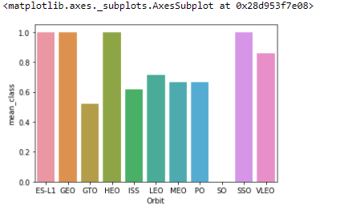
Success Rate vs. Orbit Type
The orbit Type ES-L1,Geo,Heo and SSO has highest success rate.

Slide 23
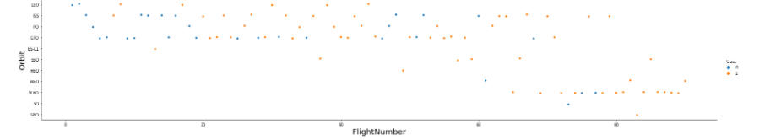
Flight Number vs. Orbit Type
The Success of LEO orbit related to the number of flight.
There is no relationship between the flight number and geo orbit.

Slide 24
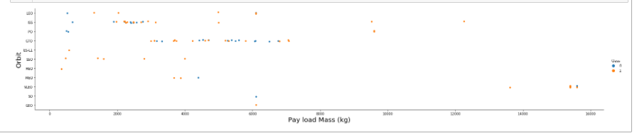
Payload vs. Orbit Type
The successful landing of Polar , Leo and ISS depends on light payload.
For GTO orbit is not distinguishable by payload mass

Slide 25
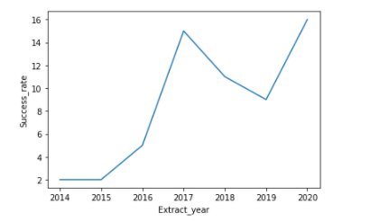
Launch Success Yearly Trend
The success rate is increasing from 2015

Slide 26
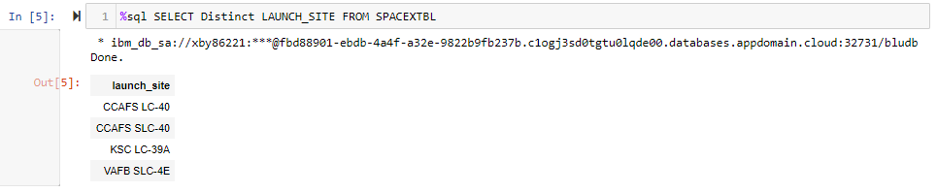
All Launch Site Names
There are four unique launch site in the dataset

Slide 27
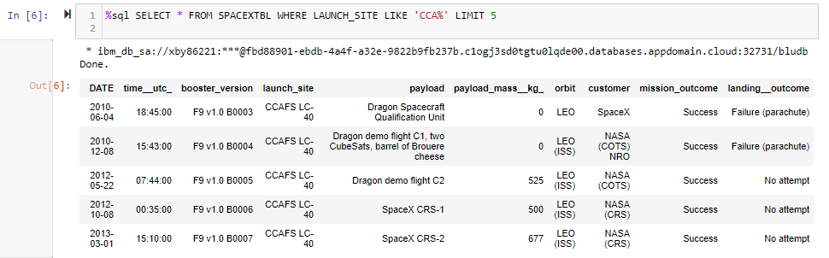
Launch Site Names Begin with 'CCA'
Find the Launch site name from the dataset applying where clause with Like operator into Launch site columns

Slide 28
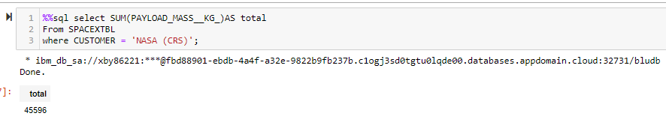
Total Payload Mass
The total payload mass is 45596 kg.
Using SUM operator in payload mass column from SPACEXTBL database and apply where clause to customer column.

Slide 29
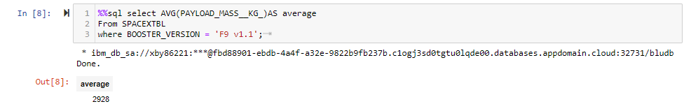
Average Payload Mass by F9 v1.1
The average payload mass carried by booster version F9 v1.1 is 2928 kg
From SPACEXTBL database, use AVG operator in payload mass column and apply where clause in booster version column specify the version F9 v1.1.

Slide 30
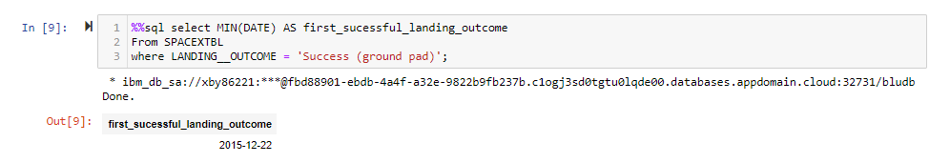
First Successful Ground Landing Date
The dates of the first successful landing outcome on ground pad is 2015-12-22
From SPACEXTBL database use min operator DATE column and apply where clause to Landing outcome column with condition Success ( ground pad)

Slide 31
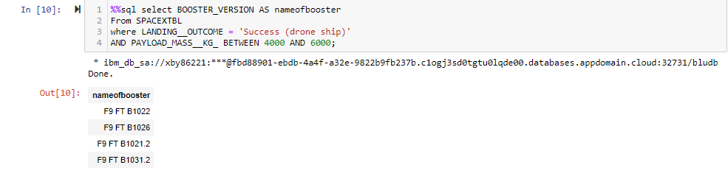
Successful Drone Ship Landing with Payload between 4000 and 6000
From SPACEXTBL database select BOOSTER_VERSION column with where clause.
In where clause we use AND operator with Landing outcome with Success(drone ship) and payload mass kg column. In payload mass column we use between operator with the numbers 4000 and 6000 as a condition to meet the query

Slide 32
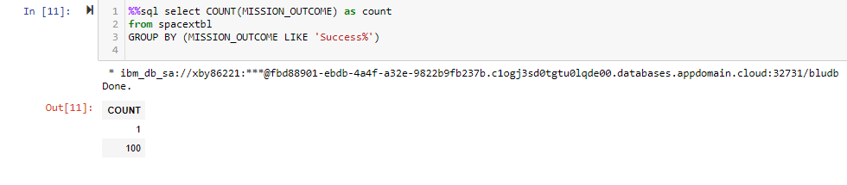
Total Number of Successful and Failure Mission Outcomes
From SPACEXTBL database select MISSION_OUTCOME with count operator and apply group by clause to MISSION_OUTCOME column. In MISSION_OUTCOME column I use Like operator with 'Success%' condition
The total number of successful mission outcomes is 100 and faliure mission outcome is 1

Slide 33
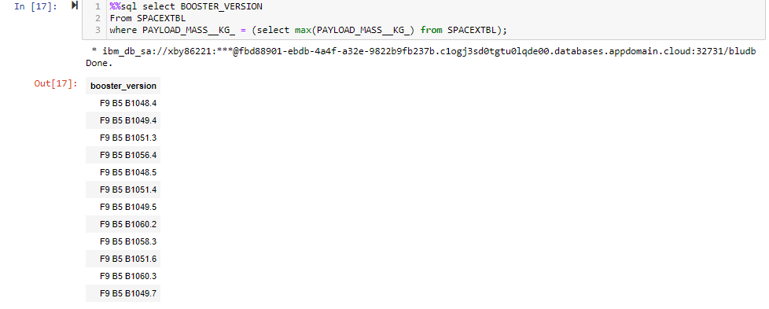
Boosters Carried Maximum Payload
From spacextbl database select booster version column with where clause.In where clause I use subquery which finds maximum payload mass from the database.
Present your query result with a short explanation here

Slide 34
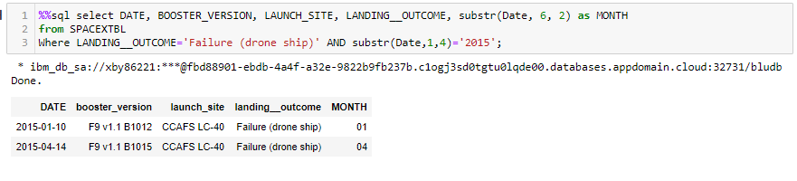
2015 Launch Records
From spacextbl database we select date, booster_version, launch_site, landing outcome and use where clause and 'AND' operator to landing outcome and date columns. In date column we use substring operator to extract the year.
Present your query result with a short explanation here

Slide 35
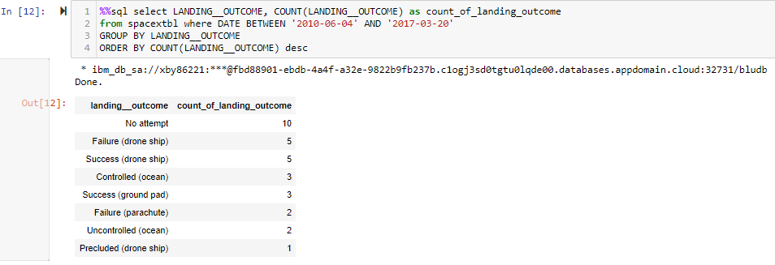
Rank Landing Outcomes Between 2010-06-04 and 2017-03-20
Selecting landing outcome with count operator from spacextbl database and where clause with date columns with between and 'AND' operator and apply group by and order by clause with descending order to landing outcome column
Present your query result with a short explanation here

Slide 36

Section 3

Slide 37
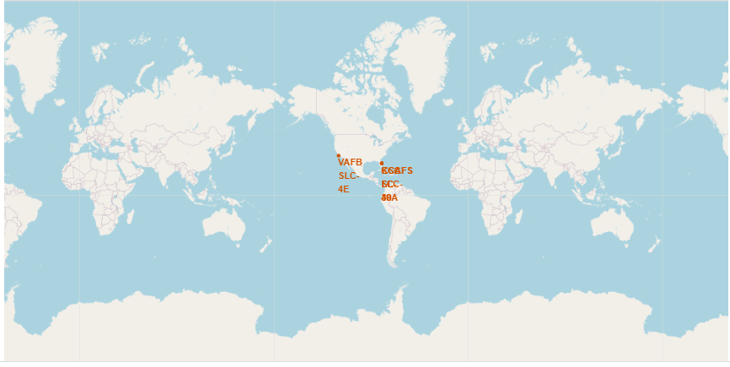
Geographic map of all Launch Site Using Folium
All the launch site is very close to coast and equator line.
There are four launch site areas :CCAFS LC-40,CCAFS SLC-40, KSC LC-39A, VAFB SLC-4

Slide 38
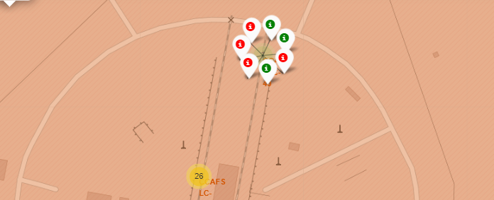
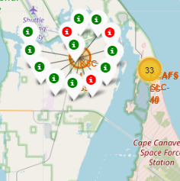
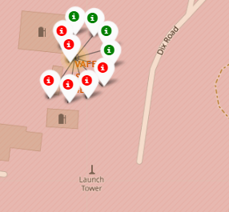
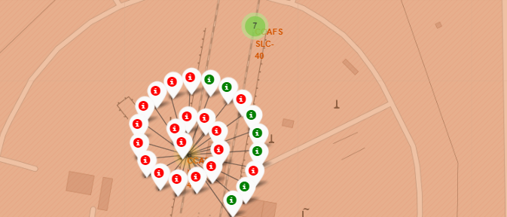
The success/failed launches for each site on the map
The four unique launch sites with mark successful and failed launches.
Successful launches are mark with green color and failed launches are marked with red color

Slide 39
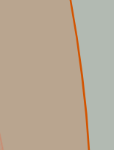
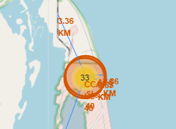
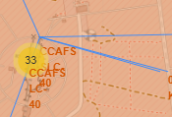
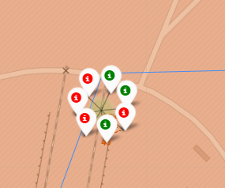
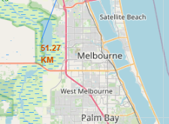
The distances between a CCAFS SLC –40 launch site from its nearest railway, highway and coastline)
The launch site is much far from Melbourne rather than coastline, highway and railway.

Slide 40

Section 4

Slide 41
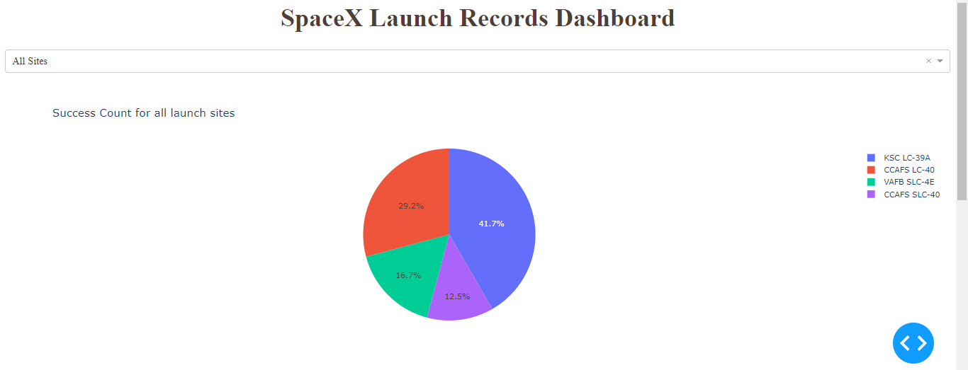
The pie chart of successful launch count
KSC LC-39A has the highest
Success rate

Slide 42
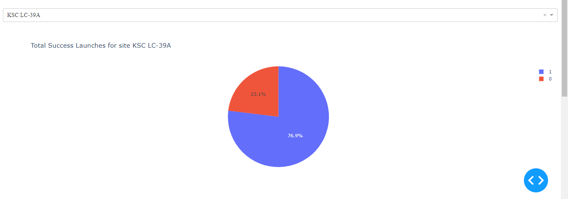
The highest launch success is the KSC LC-39 A
The pie chart of highest launch success

Slide 43
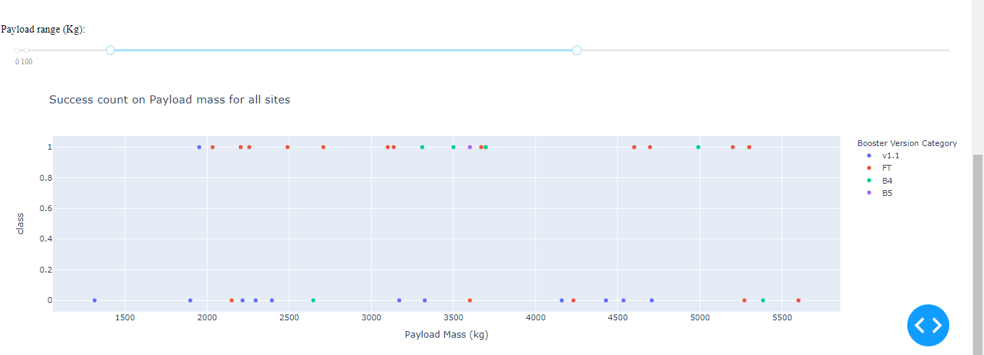
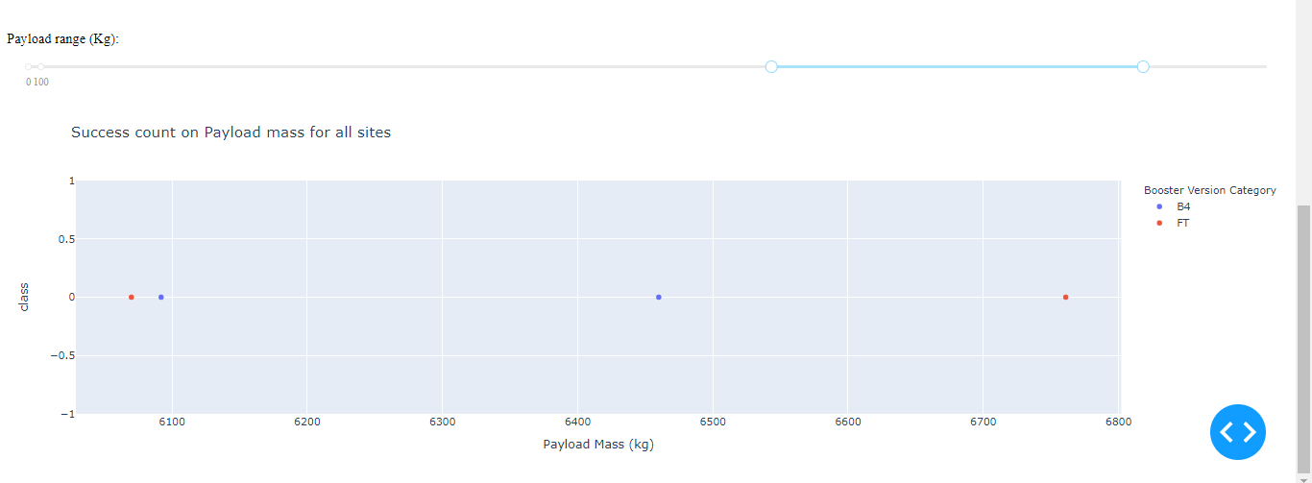
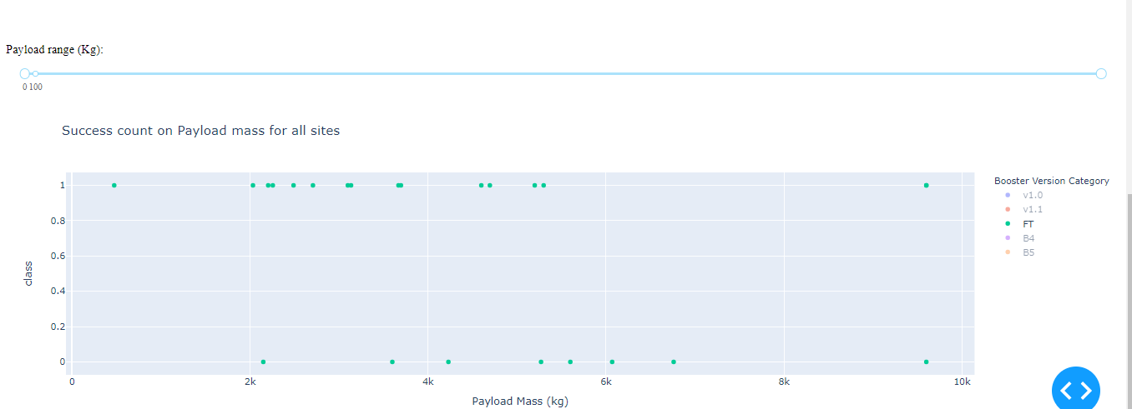
Payload vs. Launch Outcome
The payload range of highest launch success rate is 2000-6000kg
For the lowest launch success rate is
6000 – 6800kg
FT booster version has highest launch success rate

Slide 44

Section 5

Slide 45
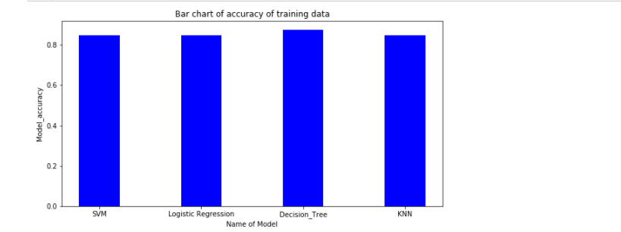
Classification Accuracy
Decision tree has highest model training accuracy

Slide 46
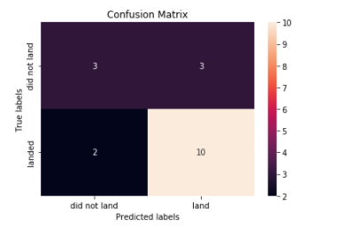
Confusion Matrix
The confusion matrix of the best performing model is decision tree model. It can distinguish between two classes .But the major problem is false positive.

Slide 47
Conclusions
The successful launch depends on several factors for example launch site, orbit, payload mass etc. As the flight number and years increases the landing becomes more successful. From EDA we found The ES-L1,Geo,Heo and SS0 are orbits for successful landing. Payload is another factor for successful launch landing. For successful launch we need light payload. There is no successful landing for VAFB-SLC launch site on heavy payloads. From the dataset we cannot explain which launch site is better than others. We need to incorporate more attribute for it. From modelling experiment ,from the four model, decision tree performs best as it is best training accuracy.

Slide 48


